Slide 1
PRESENTATION A practical use of coding theory Industrial placement concerning Bitcoin and cryptography by Quentin McGaw, 17/10/2015 (Imperial College London)

Slide 2
Contents summary
A very quick overview of Bitcoin
Different solutions to protect Bitcoin private keys
An enhanced secret sharing
Conclusion

Slide 3
1. A very quick overview of Bitcoin

Slide 4

1.1 What is Bitcoin and what was my work about
Bitcoin is a digital currency and a technology (protocol) launched in 2009.
2008: Bitcoin protocol described in an anonymous paper.
2009: Bitcoin launched as an open source software.
Safe
Bitcoin funds
Unsafe
Bitcoin private key
My goal was to develop an enterprise solution to protect Bitcoin private keys.

Slide 5
1.2. A better glimpse of Bitcoin credentials
1.3 bitcoin
Alice
Bob
Bitcoin private key (256 bits)
Bitcoin digital signature (ECDSA)
Bitcoin private key (256 bits)
Bitcoin funds
Bitcoin address (public)
Spending bitcoins
Bitcoin address (public)
11.3
25.0
bitcoins
10.0
bitcoins
23.7

Slide 6
2. Different solutions to protect Bitcoin private keys

Slide 7
2.1. The first idea: Encrypting with a password
Password
Low entropy
Secret
Encryption
Encrypted secret
ADVANTAGES: Ease of use Resistant to stealing – The password is not stored.
PROBLEM: Vulnerable to bruteforce attack – a human-entered password has low number of entropy bits

Slide 8

2.2. Solving the bruteforce problem: high entropy key
Random 256 bit key
High entropy
Secret
Encryption
Encrypted secret
ADVANTAGE: Resistant to bruteforce attack – $2^{256}$ possibilities.
PROBLEMS: Vulnerable to stealing – the key is stored. Vulnerable to loss – if the key is lost, the secret is lost.
Making copies of the key makes stealing easier.

Slide 9
2.3. Making stealing harder: repeated encryption
Random 256 bit key 1
Random 256 bit key 2
Random 256 bit key N
Secret
Encryption
Encryption
Encryption
N times encrypted secret
ADVANTAGES: Resistant to bruteforce attack
Resistant to stealing – An attacker needs all the N keys.
PROBLEM: Vulnerable to loss, even more.

Slide 10
3. An enhanced secret sharing

Slide 11
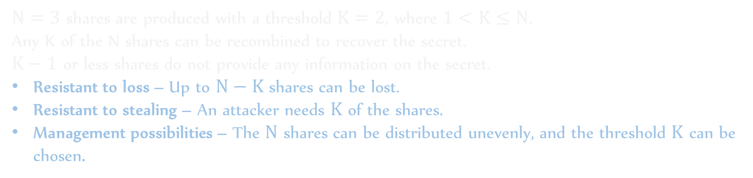

3.1. What is a secret sharing scheme? (you probably know already)
Share 1
Secret
Secret Sharing
Share 2
Threshold $K=2$
Share 3
$N=3$ shares are produced with a threshold $K=2$, where $1<K≤N$.
Any K of the N shares can be recombined to recover the secret.
$K−1$ or less shares do not provide any information on the secret.
Resistant to loss – Up to $N−K$ shares can be lost.
Resistant to stealing – An attacker needs $K$ of the shares.
Management possibilities – The $N$ shares can be distributed unevenly, and the threshold $K$ can be chosen.

Slide 12

3.2. Space efficiency
PROBLEM: Shamir secret sharing produces shares each with the size of the secret.
Share 1 (256 bit)
Shamir Secret Sharing
“Shared key”, random 256 bit key
…….
Share N (256 bit)
Secret (i.e. 1GB file)
Encryption
Encrypted secret (i.e. 1GB encrypted file)
NEW ADVANTAGE: Space efficient – $Size(secret)+N×256 bits$

Slide 13
3.3. A first try towards ease of use
PROBLEMS: Sending the N shares each time to different persons/entities is complicated. Relying on a communication channel adds a security risk.
Password 1
Share 1
Encryption
Encrypted share 1
Password N
NEW PROBLEMS: Vulnerable to bruteforce attacks. Vulnerable to malwares such as keyloggers.
Hard to use in reality – N passwords must be entered each time a secret is shared to encrypt the shares generated.
Share N
Encryption
Encrypted share N
NEW ADVANTAGES: Ease of use – All the encrypted shares can be stored at the same place. Resistant to hacking – Passwords are not stored or sent.

Slide 14



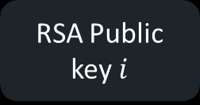

3.4. Use of asymmetric encryption
Asymmetric encryption allows to store encryption keys (public keys) on the machine.
USB key
.INI file
RSA Public key $i$
RSA Private key $i$
.CSV file
Decryption (RSA)
Encryption (RSA)
Encrypted share $i$
Share $i$
Share $i$
N RSA public keys are stored in the .ini file to encrypt the N shares produced.
K of the N corresponding RSA private keys can recover the secret.

Slide 15
4. Conclusion: advantages of the final solution
Resistant to bruteforce attacks (RSA uses keys larger than 1024 bits)
Resistant to hacking – RSA private keys are not sent and are stored offline on different USB keys.
Resistant to malwares – RSA private keys are not entered manually, are never copied on the machine and are only read from external USB keys plugged only when necessary.
Better resistance to stealing – as long as the N RSA private keys are stored at different locations.
Ease of use – RSA public keys are stored on the machine and re-used to encrypt as many shares as needed. RSA private keys are read from USB keys for simplicity as well.
Space efficient
Resistant to loss of key(s)

Slide 16
Questions (and answers)

Slide 17


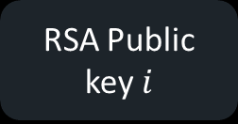
Appendix: Overall system: Protection
.INI file
Share 1
RSA Public key $i$
.CSV file
Shamir Secret Sharing
…….
256 bit key
Encryption (RSA)
Encrypted share $i$
Share $i$
…….
Share N
Secret
Encryption
Encrypted secret

Slide 18
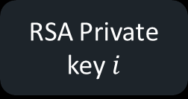



Appendix: Overall system: Recovery
USB Key
RSA Private key $i$
1st share
.CSV file
…….
Shamir Secret Reconstruction
Encrypted share $i$
Decryption (RSA)
$i^{th}$ share
256 bit key
…….
$K^{th}$ share
Encrypted secret
Decryption
Secret

